Slide 1

CT Project Risk Management
This document is confidential and contains proprietary information, including trade secrets of CitiusTech. Neither the document nor any of the information contained in it may be reproduced or disclosed to any unauthorized person under any circumstances without the express written permission of CitiusTech.

Slide 2
Contents
How an Issue is Born?
Let us Reverse the Situation
What is Risk?
Basic Thoughts on Mitigating
Forum to Highlight Risks
Put your Thinking Cap on ☺
Process of Risk Management
Management/Leadership Involvement
Who are the Actors – Bring Focus to Everyone’s Onus
Good Practices and QMS help
Real-Life Use Cases

Slide 3
How an Issue is Born? (1/4)
Scenario I:
You have a meeting in the evening with the client at 6:00 PM:
You go to book the room at 5:00 PM in the evening (there are no rooms available)
Scenario II:
You have a meeting in the evening with the executive management at 5:00 PM:
You go to the booked room & there is no projector in the room (call IT to help – 5:10 PM)
You come to know there are remote participants attending, you need to setup the web-meeting (Created the meeting invite and shared the details – 5:15 PM)
You open your presentation but it takes too long to enter the show mode (You close a few other open apps on the machine – 5:20 PM)
Finally, you get started at 5:21 PM

Slide 4
How an Issue is Born? (2/4)
Scenario III:
Project of 2 months duration needs to be delivered by November 30th:
You have already committed to the customer
In November 1st week you get approval requests for Diwali vacation of all team members and project is only 40% complete
You cannot reject Diwali vacations!!!
Scenario IV:
Project of 3 months duration needs to be extended since deliverables are not met
You knew that the deadline is not achievable
You never spoke about it to your manager and neither to the client
You tried best but it didn’t work
You informed the client just 2 weeks before the final release and the client is completely disappointed

Slide 5
How an Issue is Born? (3/4)
Think that Nothing can go wrong, and an issue would be born!
Scenario I:
Trying to book the room just an hour before the meeting – When no rooms were available
Scenario II:
Not anticipating that the conference room would not have a projector
Expecting all attendees would attend from the same location
Expecting the machine runs with no hindrances while running the PPT show
Scenario III:
Assuming that all the team members would be present for the entire project duration
Not planning for the leaves
Scenario IV:
Assuming that trying best to reach something which is impossible will work better rather than intimating about the risk to appropriate parties

Slide 6
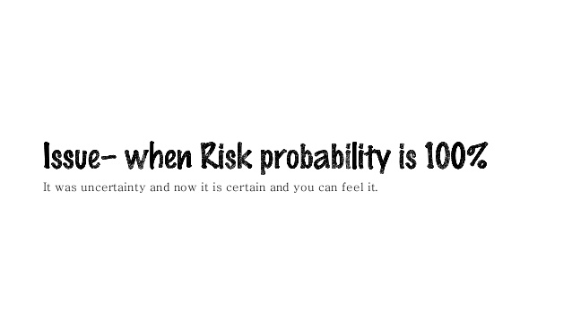

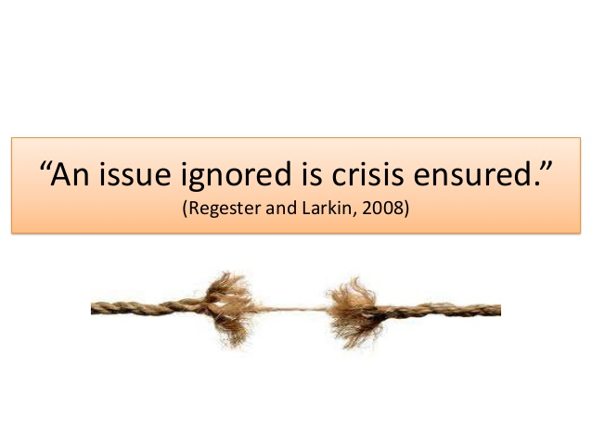
How an Issue is Born? (4/4)

Slide 7
Contents
How an Issue is Born?
Let us Reverse the Situation
What is Risk?
Basic Thoughts on Mitigating
Forum to Highlight Risks
Put your Thinking Cap on ☺
Process of Risk Management
Management/ Leadership Involvement
Who are the Actors – Bring Focus to Everyone’s Onus
Good Practices and QMS help
Real-Life Use Cases

Slide 8
Let us Reverse the Situation (1/2)
Think before you leap
Scenario I:
Book the room well before time to avoid any last minute running around
Scenario II:
Assess the needs for the meeting – projector, cables, phones, web conferences, speakers, markers
Ensure that your machine is in a ready to show state
Scenario III:
Plan end dates for the project based on the leave plans for the team, anticipate holiday seasons where team strength would be very low
Scenario IV:
Highlight issue whenever realized rather than trying hard to achieve and intimating it too late.

Slide 9
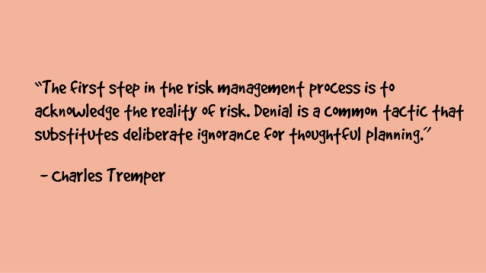
Let us Reverse the Situation (2/2)
Scenario I:
Meeting starts at 6:00 PM sharp and you welcome all client attendees
Scenario II:
Meeting starts at 5:05 PM sharp
You are ready with your presentation to deliver
Scenario III:
You suggest the dates of project delivery based on the leave plans
Scenario IV:
Client is aware about the correct release date which helps him to commit back to his clients and management

Slide 10
Contents
How an Issue is Born?
Let us Reverse the Situation
What is Risk?
Basic Thoughts on Mitigating
Forum to Highlight Risks
Put your Thinking Cap on ☺
Process of Risk Management
Management/ Leadership Involvement
Who are the Actors – Bring Focus to Everyone’s Onus
Good Practices and QMS help
Real-Life Use Cases

Slide 11
What is Risk?
Risk is an uncertain event or condition that, if occurs, has an effect on at least one project objective i.e. scope, schedule, cost and quality.
Risk conditions could include aspects of project’s or organization’s environment that may contribute to project risk, such as immature project management practices, lack of integrated management systems, concurrent multiple projects or dependency on external participants who cannot be controlled.

Slide 12
Contents
How an Issue is Born?
Let us Reverse the Situation
What is Risk?
Basic Thoughts on Mitigating
Forums to Highlight Risks
Put your Thinking Cap on ☺
Process of Risk Management
Management/ Leadership Involvement
Who are the Actors – Bring Focus to Everyone’s Onus
Good Practices and QMS help
Real-Life Use Cases

Slide 13
Basic Thoughts on Mitigating
Any assignment be it the smallest room booking or be it planning a project, there are risks of it not happening as smoothly as expected
Start with identifying the expected mishaps, brainstorm with your team, identify all the possible and rarest of issues that can be a blocker
Take actions, assess the risks, highlight the risks, bring attention to the risks, and feel confident by being proactive on taking care of these risks!

Slide 14
Contents
How an Issue is Born?
Let us Reverse the Situation
What is Risk?
Basic Thoughts on Mitigating
Forum to Highlight Risks
When to Highlight?, What to Highlight?, Whom to Highlight?
Put your Thinking Cap on ☺
Process of Risk Management
Management/ Leadership Involvement to Help
Who are the Actors – Bring Focus to Everyone’s Onus
Good Practices and QMS help
5 Real-Life Use Cases

Slide 15
Forum to Highlight Risks
Many mediums can be used to get proper attention to your issues and risks
For scrum based projects
You highlight the impediments in your daily scrum
You highlight bigger issues and impediments in your scrum of scrum calls or weekly, monthly dashboard
For project issues
You email your immediate leads about the issues and risk
You bring attention to it in the fortnightly meetings (AnPs) and request help for solving those, at the same time track those to closure

Slide 16
When, What and Whom to Highlight?
It is important to assess which risk needs what kind of attention and whose attention
It would not be helpful to let your MDL know about a daily scrum call impediment, but that is of huge importance to the scrum master
At the same time, you need to highlight a case of poor performer to your manager immediately before the client escalates about the same
Forum of highlighting issues is also of utmost importance. For e.g. you need to highlight project issues and risks in the AnP meetings which needs the attention and tracking from the senior management, these shouldn’t be highlighted in client meetings directly

Slide 17
Contents
How an Issue is Born?
Let us Reverse the Situation
What is Risk?
Basic Thoughts on Mitigating
Forum to Highlight Risks
Put your Thinking Cap on ☺
Process of Risk Management
Management/ Leadership Involvement to Help
Who are the Actors – Bring Focus to Everyone’s Onus
Good Practices and QMS help
5 Real-Life Use Cases

Slide 18

Put your Thinking Cap on ☺
All said, to really bring such a plan in action, everyone needs to be “A Thinker”
Before you plan for an activity think well of the possible issues, concerns, difficulties that can be foreseen
Identify the risks in taking any decisions
Evaluate the risks & mitigate the risks
A Thinker

Slide 19
Contents
How an Issue is Born?
Let us Reverse the Situation
What is Risk?
Basic Thoughts on Mitigating
Forum to Highlight Risks
Put your Thinking Cap on ☺
Process of Risk Management
Management/ Leadership Involvement
Who are the Actors – Bring Focus to Everyone’s Onus
Good Practices and QMS help
Real-Life Use Cases

Slide 20
Process of Risk Management (1/2)
Steps | Description
Planning a Risk Management | Process to define how to conduct risk management activities
Identify Risks | Process to identify the risks that would affect the process/project.
Perform Qualitative and Quantitative Risk Analysis | Numerically analyzing the effect of identified risk. Could be days, billing, attrition of team, addition of team members etc. Prioritizing risk by accessing and combining their probability of occurrence and impact
Planning Risk Responses | Developing actions to enhance opportunities and reduce threats

Slide 21
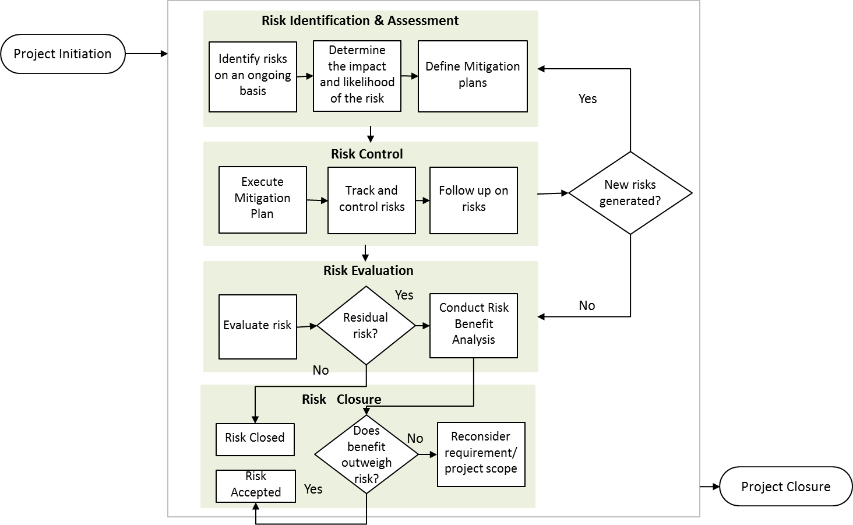
Process of Risk Management (2/2)

Slide 22
Risks – Plan Risk Management (1/3)
Plan
Risk
Management
Stakeholder
Meetings
Team
Meetings
Project Management Plan
Organization Policies
Expert Judgement
Quality Management System
Tools
Impacts
Risk Management Methodology: Defines the sources, tools that can be used to perform risk management
Roles and Responsibility: Defines the resources and lists their responsibility
Budgeting: Estimates funds, identifies resources and establishes protocols
Timings: Identifies the frequency of performing risk management
Risk Categories: Defines a structure that identifies the Risk Categories
Probability and Impact Matrix: Defines the risk probability and impact
Stakeholder Tolerances: Defines the degree of uncertainty that a stakeholder accepts in the project

Slide 23
Risks – Plan Risk Management (2/3)
Risk Sources - Typical internal and external risk sources include:
Inputs from Sales to Service handover document.
MSA / SOW Requirements.
Uncertain requirements / Unfeasible design.
Safety aspects / Security aspects.
Unrealistic schedule estimates / Inadequate staffing and skills.
Inadequate communication with customers or with their representatives.
Regulatory constraints (for example, security, safety, environment).

Slide 24
Risks – Plan Risk Management (3/3)
Identify & categorise risks associated with the project. Risks are categorised as:
Technical
Requirements
Complexity
Safety
Impact on Human Health & Safety
Business
Execution (Project Mgmt.)
Technology
Reliability
Performance
Quality
Funding
Vendors
Estimation
Planning
Controlling
Communication
Resources
Project Dependencies
Prioritization
Market
Customer
Subcontractors
Regulatory
Security
Access to PHI Data
Unauthorized access
Data Integrity
Data Security
Data Theft

Slide 25
Risks – Identify Risk
Identify
Risk
Brainstorming
Interviewing
RCA
Diagramming
SWOT
Analysis
Tools to identify risks
Results
List of Risks: List of Risks are identified in detail along with the conditions or events that give rise to these risks
Risk Responses: Responses/Mitigation to the risks can be identified at this stage
Identify and document the risks in QMS→ Supporting→ Project Risk Management Module

Slide 26
Risks – Qualitative & Quantitative Risk Analysis (1/3)
Qualitative
Risk
Analysis
Risk Probability
Probability and Impact Matrix
Risk Classification
Risk Urgency
Tools to analyze risk
Results
Risk Ranking: Based on the probability and impact the Risk can be classified as Low, Medium, High and Very High. Risks can also be prioritized separately for cost, schedule and performance
Risk Classification: Can help you to reveal root causes or even separate the risks in to separate project areas
Identification of near response Risks: Identify risks that need to be responded urgently
Trends: After repeated analysis, a trend for a particular risk become apparent. This could even result in any proactive measure for risk mitigation

Slide 27
Risks – Qualitative & Quantitative Risk Analysis (2/3)
Risk Assessment
Conduct risk analysis to identify the impact, likelihood & mitigation controls for risk.
Risk may have impact on schedule, performance, quality, regulatory requirements etc.
Risks impact rankings are as follows –
Very High (Value- 4)
High (Value- 3)
Medium (Value- 2)
Low (Value- 1)
Assess likelihood of the risk occurrence.
Risks likelihood rankings are as follows –
Very High (Value - 4) - Very Frequent -(Occurrence >=75% )
High (Value- 3) - Frequent (Occurrence >=50 & <75%)
Medium (Value- 2) -Occasional (Occurrence >=25 & <50%)
Low (Value- 1) - Unlikely ( Occurrence <25%)

Slide 28
Risks – Qualitative & Quantitative Risk Analysis (3/3)
Risk Acceptance Criteria
Risk level = Impact x Likelihood of occurrence.
Risk analysis is done based on the risk level value.
Risk analysis matrix for evaluating the risk acceptance is as below.
Risk is acceptable if Risk Level is =< 6
Impact Likelihood | Very High (4) | High(3) | Medium (2) | Low(1)
Very High (4) | 16 | 12 | 8 | 4
High(3) | 12 | 9 | 6 | 3
Medium (2) | 8 | 6 | 4 | 2
Low(1) | 4 | 3 | 2 | 1
Analyse and document the impact and likelihood of the risks in QMS→ Supporting→ Project Risk Management Module

Slide 29
Risks – Plan Risk Responses (1/3)
Impacts
Tools
Plan
Risk
Management
Strategies for Negative Risks
Strategies for Positive Risks
Conflicts Management
Contingent Response Strategy
Negative Risks: Avoid, Transfer, Mitigate, Accept
Positive: Exploit, Share, Enhance, Accept
Contingent Response: Events triggering contingency response to be defined and tracked
Risk Status
Open: Mitigation action not yet implemented / mitigation actions in progress
Closed: Mitigation action implemented
Accepted: The risk involved is not adequate enough to warrant the added cost it will take to avoid that risk / benefit from implementing the actions.

Slide 30
Risks – Plan Risk Responses (2/3)
Risk Mitigation & Control
Identify the risk mitigation plans / controls.
Mitigation plans reduce likelihood or impact of a risk.
Implement the risk mitigation actions.
Monitor the progress of mitigation actions.
Perform reviews to track the mitigation plans as part of regular project monitoring.
Identify any new risks that may arise from implementation of mitigation.
Identify and document risk response / mitigation in QMS→ Supporting→ Project Risk Management Module

Slide 31
Risks – Plan Risk Responses (3/3)
Risk Evaluation
Risk is evaluated for any residual risks i.e. risk impact & probability after implementing the mitigation actions.
In case of absence of residual risk, existing risk is closed.
In case residual risk exists, risk is analysed and revised impact and likelihood for the risk is determined.
Mitigated Risk
Risk Evaluation
Evaluate Risk
Residual Risk?
Yes
Conduct Risk Benefit Analysis
No
Risk Closure
Risk Closed
Does benefit outweigh risk?
Reconsider requirement/ project scope
No
Risk Accepted
Yes

Slide 32
Contents
How an Issue is Born?
Let us Reverse the Situation
What is Risk?
Basic Thoughts on Mitigating
Forum to Highlight Risks
Put your Thinking Cap on ☺
Process of Risk Management
Management/ Leadership Involvement
Who are the Actors – Bring Focus to Everyone’s Onus
Good Practices and QMS help
Real-Life Use Cases

Slide 33
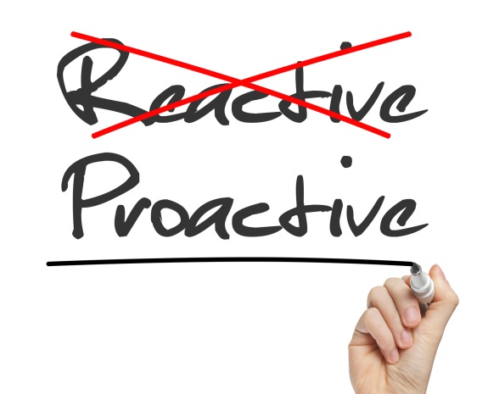
Management/ Leadership Involvement
At any point of time being proactive is always valued than being reactive
Speaking up is much appreciated than saying “Yes, I always knew this could have happened”
CitiusTech values the “No surprises policy” and the “Open door policy” – Both of these mean, share your thoughts and ask for help from any sr. management member who is apt to resolve your concerns and can help you with the risks
Do not hesitate in highlighting any issues that you see as blockers in any smooth execution of the projects or any routine activities as well
All the risks with risk level >=6 are displayed in the Senior Management Fortnightly Reviews

Slide 34
Contents
How an Issue is Born?
Let us Reverse the Situation
What is Risk?
Basic Thoughts on Mitigating
Forum to Highlight Risks
Put your Thinking Cap on ☺
Process of Risk Management
Management/ Leadership Involvement
Who are the Actors – Bring Focus to Everyone’s Onus
Good Practices and QMS help
Real-Life Use Cases

Slide 35
Who are the Actors – Bring focus to Everyone’s Onus
Every one involved in an activity, needs to be responsible for making it a success
It is a team who delivers project and hence it is everybody’s responsibility to deliver
Define responsibilities very well across the team so that everyone knows what is expected from them
Create a culture among the team to identify risks irrespective of whether it falls in your bucket since at the end it is the team who delivers and not an individual

Slide 36
Contents
How an Issue is Born?
Let us Reverse the Situation
What is Risk?
Basic Thoughts on Mitigating
Forum to Highlight Risks
Put your Thinking Cap on ☺
Process of Risk Management
Management/ Leadership Involvement
Who are the Actors – Bring Focus to Everyone’s Onus
Good Practices and QMS help
Real-Life Use Cases

Slide 37
Good Practices and QMS help
Always think before you respond to any items which require a thought
Be sure of using proper Use of AnP, Similar Applicable Forums to Highlight Risks and repeatedly highlight until the acknowledgement or resolution for the same is received
Track status of the risks/issues, share the start date of highlighting the risk, progress, expected end dates of resolution, actions taken, comments shared and owners of the risks and actions
Continue to highlight the risk until the cycle of the activity completion, so that the issue does not escape and erupt at an undesired time
QMS allows you to track project execution risks, which are linked with the AnPs as well
Few risks may need separate tracking and managing in formats which are either self designed or customer designed, or in weekly dashboards/monthly reviews

Slide 38
Project Risk Management in QMS (1/5)
Project Risk Management Landing Page
Add a new risk
Edit the risk

Slide 39
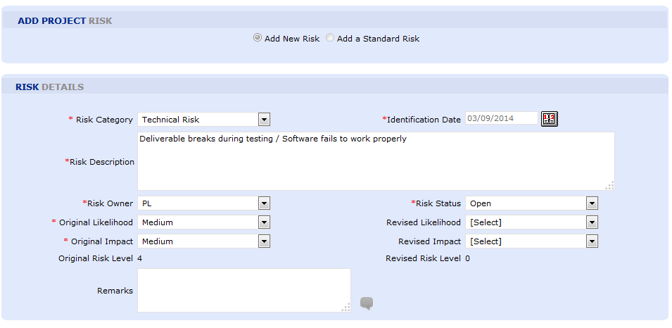
Project Risk Management in QMS (2/5)
Adding a new risk
Populate the relevant risk details.

Slide 40
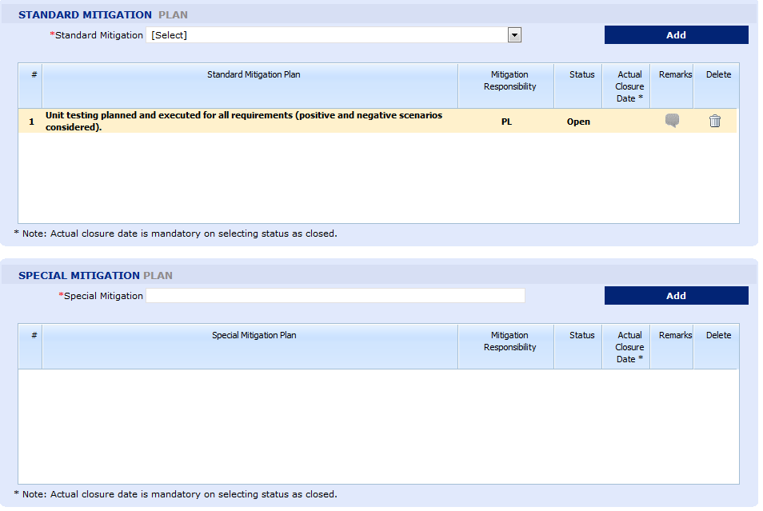
Project Risk Management in QMS (3/5)
Add the mitigation plan from the dropdown
Add standard mitigation or special mitigation plan other than mentioned in standard mitigation plan.
Populate the relevant mitigation details.

Slide 41
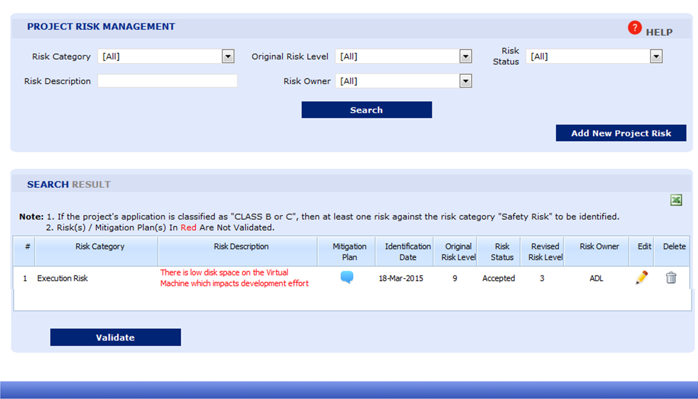
Project Risk Management in QMS (4/5)
On a six monthly basis review and validate all risks and mitigation actions identified for relevance & any changes in impact and likelihood
Risk(s) / Mitigation Plan(s) not validated will be displayed in Red.

Slide 42
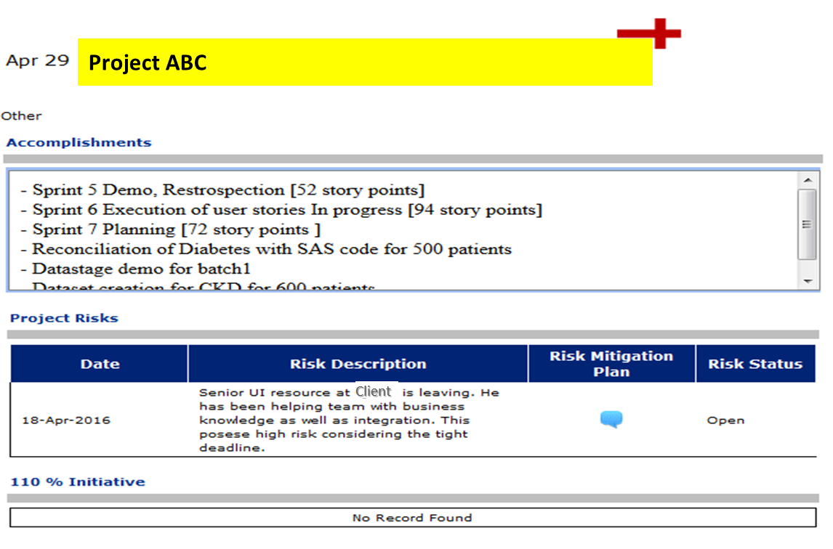
Project Risk Management in QMS (5/5)
All the risks with risk level >=6 are displayed in the Senior Management Fortnightly Reviews

Slide 43
Contents
How an Issue is Born?
Let us Reverse the Situation
What is Risk?
Basic Thoughts on Mitigating
Forum to Highlight Risks
Put your Thinking Cap on ☺
Process of Risk Management
Management/ Leadership Involvement
Who are the Actors – Bring Focus to Everyone’s Onus
Good Practices and QMS help
Real-Life Use Cases

Slide 44
Case Study #1 : Code Quality Check for New Team Member (1/2)
New Person joined and client was unhappy with the code quality
Problem
Statement
Unhappy architects raised the issue with the CT team leaders, and also informed the manager at the customer end, where customer requested for tracking the work quality for the same, and resulted into an escalation
Impact
PL discussed with the team about the feedback and how internal review missed the quality issues Team mentioned that the routine process of review was followed where newly developed code is uploaded to client repository, and CT code reviewers are marked for code review However, since the client architects were also notified about code check-in, they happened to review code as well, and eventually responded to the quality of code
Steps Taken

Slide 45
Case Study #1 : Code Quality Check for New Team Member (2/2)
The proactive thought of analyzing and reviewing the new team member’s code before posting to the client repository, since the code will be exposed to clients too could have saved the team from the escalation
What could have been done differently?

Slide 46
Case Study # 2 : Handling Aspirations of Team Member (1/2)
CitiusTech related concerns, aspirations shared with the client in casual discussions
Problem
Statement
Customer was upset knowing about the concerns, raised issues with CitiusTech management teams about the team’s dissatisfaction. This raised credibility questions on CT’s relationship with the customer
Impact
Project team’s were given the background of how sensitive information shared with the customer can cause huge impacts to the long term relationships with the customer Appropriate communication routes for handling concerns were shared with the team PLs took proper actions to address concerns timely going forward Team was made aware of how we need to strike a balance between the required transparency between CTs and Customer’s interactions, at the same time making good judgement about whether an information is sensitive or not to be shared with the customer
Steps Taken

Slide 47
Case Study # 2 : Handling Aspirations of Team Member (2/2)
The pro-activeness in addressing team’s concerns and bringing faith in them, so that they don’t resort to client for assistance Discussing with the teams on how to handle client communication, making good judgement on sharing sensitive information, ensuring professionalism and avoid damaging reputation with casual conversations with the customer
What could have been done differently?

Slide 48
Case Study # 3 : Planning Migration Activity (1/2)
Migration activities for Go-live were not well planned
Problem
Statement
Customer dissatisfaction regarding unplanned production migration activities. Necessary resources to tackle unexpected issues were not present since it was a weekend activity, resulting into postponing of the Go-Live
Impact
Project team’s were given the background of how the customer’s expectations were not met due to the unplanned migration activity, and how the Go-Live was impacted and rescheduled causing inconvenience to the customer’s customers
Steps Taken

Slide 49
Case Study # 3 : Planning Migration Activity (2/2)
Proactively discussing and planning all the needs by coming up with a checklist for a Go-Live activity Listing all contacts who may need to be reached out to, and also informing them of needed support on the weekend in advance, especially expecting non-availability of these resources on the weekends Planning for unplanned hindrances better, so that mitigating these activities become faster
What could have been done differently?

Slide 50
Case Study # 4 : PHI Breach while Using Actual Test Data (1/2)
PHI data breach incident due to usage of real time data for testing. Test/Development environments contained client’s customer’s actual contact information, which was accidently used for dev/test cycles
Problem
Statement
Customer’s business was impacted in a huge way due to test emails sent out to actual customers, since code programs used actual contact information from the test DBs
Impact
Project team’s were informed about precautionary measures to be taken while dealing with customer environments Especially in the case of customer environment where email addresses, postal addresses or phone numbers can exist in their DBs in unmasked forms Special attention in observing the data being used in their programs and assessment of their probable impacts
Steps Taken

Slide 51
Case Study # 4 : PHI Breach while Using Actual Test Data (2/2)
Proactively understand the functionality being developed, its interactions with the external environments, in this case emails being sent out publicly Reviewing data being used, fetched, even while using client environments Identifying similar situations/risks well before dev and test phases Being aware of the entire environment in which the development or test cycles are being executed, and of all end points being used
What could have been done differently?

Slide 52
Case Study # 5 : Late Intimation of Resignation to Customer (1/2)
Client was not intimated of the resigned team member in a timely manner impacting their project schedules
Problem
Statement
Customer dissatisfaction regarding the unplanned resource gap since he was given a very short notice about the resignation of few key members on the team Resulted into impact on customers project planning and unexpected loss of an important asset Knowledge transitions and discussions couldn’t happen well in time
Impact
Customer was reassured about having the lost positions filled up quickly with equally qualified candidates PLs were informed about planning such resignation activities well in advance, and informing the customer in time, to allow them to take actions and plan better on their end too
Steps Taken

Slide 53
Case Study # 5 : Late Intimation of Resignation to Customer (2/2)
Letting the customer know at least a month in advance about the resignation Plan a backfill and KT to the other members in order to avoid loss of knowledge of the customer’s business Allowing the customer to discuss with the key members of their aspirations within that project (only applicable if the DL approves of it) to retain the employee on the project
What could have been done differently?

Slide 54
Case Study # 6 : Quality/Quantity of Data for Testing
QA on project module was completed with a small set of test data which didn’t cover most of the scenarios and hence during actual UAT there were too many issues
Problem
Statement
The release had to be delayed to accommodate the defects
Impact
Team had to spend extra hours in fixing the defects to ensure that release is not delayed enormously
Steps taken
Before the development, the team needs to understand the volume of the data that will be used by the module PLs should ask for actual data to identify any performance issues or issues related to the data itself for testing from customer
What could have been done differently?

Slide 55
Case Study # 7 : Unavailability of Resources with Niche Skills
Project was working on niche skills and there were additional request by customer. Recruitment took very long to ramp up the team
Problem Statement
We lost the opportunity since additional resource request was called out by the customer due to long waiting period
Impact
Ideally have 1 or 2 additional people in the team working in NA capacity Come up with a course for the respective niche skill. If the need arises, some internal folks can be trained and made available
What could have been done differently?

Slide 56
Case Study # 8 : Sharing of PHI Data (1/2)
Actual patient data was shared unknowingly by one of the team member on a forum while asking for a solution to the technical problem faced
Problem Statement
As it was patient data that was put on public forum, it was considered as a HIPAA violation for which CT received a stern warning
Impact
PL had informed the Chief Security Officer on PHI breach CitiusTech InfoSec team took immediate action to get the information out of the public forum Team was given a training on HIPAA to create enough awareness and to avoid such circumstances in future
Steps Taken

Slide 57
Case Study # 8 : Sharing of PHI Data (2/2)
We should not be working on PHI data, always use de –identified data Make use of PHI vault in case there is really a need to get PHI data offshore Make sure that no PHI information is shared in emails, chats, attachments etc.
What could have been done differently?

Slide 58
Exercise
Topic
Risk Identification
Duration
15 Minutes (10 Mins for Case Study + 5 Mins discussion)

Slide 59
THANK YOU

